Slide 1
Java- IO API

Slide 2
Java Input/output (I/O) deals with reading data from a source and writing data to a destination.
Typically, we read data stored in a file or write data to a file using I/O.
The java.io and java.nio packages contain Java classes that deal with I/O.
The java.io package has classes to perform I/O.
The java.nio package is new I/O package.
The classes in the java.io package are all about the stream based I/O operations.
The stream-based I/O uses streams to transfer byte data between a data source and a Java program.
The Java program reads from or writes to a stream a byte at a time. This approach to performing I/O operations is slow. A stream can be used for one-way data transfer. An input stream can only transfer data from a data source to a Java program and an output stream can only transfer data from a Java program to a data destination.

Slide 3
The New Input/Ouput (NIO) solves the slow speed problem in the stream-based I/O.
A channel is like a stream. It represents a connection between a data source and a Java program.
A channel provides a two-way data transfer facility. We can use a channel to read data as well as to write data.
We can obtain a read-only channel, a write-only channel, or a read-write channel.
A buffer is a bounded data container and has a fixed capacity that determines the upper limit of the data it may contain.
In stream-based I/O, we write data directly to the stream. In channel-based I/O, we write data into a buffer and we pass that buffer to the channel, which writes the data to the data destination.
When reading data from a data source, we pass a buffer to a channel. The channel reads data from the data source into a buffer.

Slide 4
Java 7 introduced New Input/Output 2 API, which provides a new I/O API. It provides many features that were lacking in the original File I/O API.
It adds three packages to the Java class library: java.nio.file, java.nio.file.attribute, and java.nio.file.spi.
New Input/Output 2 API deals with all file systems in a uniform way. The file system support provided by New Input/Output 2 API is extensible.
New Input/Output 2 API supports basic file operations (copy, move, and delete) on all file systems. It has support for symbolic links.
It supports for accessing the attributes of file systems and files.
We can creates a watch service to watch for any events on a directory such as adding a new file or a subdirectory, deleting a file, etc.

Slide 5
Java- File
Java.io.File Class
The File class is Java’s representation of a file or directory path name. Because file and directory names have different formats on different platforms, a simple string is not adequate to name them. The File class contains several methods for working with the path name, deleting and renaming files, creating new directories, listing the contents of a directory, and determining several common attributes of files and directories.
It is an abstract representation of file and directory pathnames.
A pathname, whether abstract or in string form can be either absolute or relative. The parent of an abstract pathname may be obtained by invoking the getParent() method of this class.
First of all, we should create the File class object by passing the filename or directory name to it. A file system may implement restrictions to certain operations on the actual file-system object, such as reading, writing, and executing. These restrictions are collectively known as access permissions.
Instances of the File class are immutable; that is, once created, the abstract pathname represented by a File object will never change.

Slide 6
How to create a File Object?
A File object is created by passing in a String that represents the name of a file, or a String or another File object.
For example, File a = new File("/usr/local/bin/geeks");
defines an abstract file name for the geeks file in directory /usr/local/bin. This is an absolute abstract file name.
Constructors
File(File parent, String child) : Creates a new File instance from a parent abstract pathname and a child pathname string.
File(String pathname) : Creates a new File instance by converting the given pathname string into an abstract pathname.
File(String parent, String child) : Creates a new File instance from a parent pathname string and a child pathname string.
File(URI uri) : Creates a new File instance by converting the given file: URI into an abstract pathname.

Slide 7
Methods
boolean canExecute() : Tests whether the application can execute the file denoted by this abstract pathname.
boolean canRead() : Tests whether the application can read the file denoted by this abstract pathname.
boolean canWrite() : Tests whether the application can modify the file denoted by this abstract pathname.
int compareTo(File pathname) : Compares two abstract pathnames lexicographically.
boolean createNewFile() : Atomically creates a new, empty file named by this abstract pathname .
static File createTempFile(String prefix, String suffix) : Creates an empty file in the default temporary-file directory.

Slide 8
Methods
boolean delete() : Deletes the file or directory denoted by this abstract pathname.
boolean equals(Object obj) : Tests this abstract pathname for equality with the given object.
boolean exists() : Tests whether the file or directory denoted by this abstract pathname exists.
String getAbsolutePath() : Returns the absolute pathname string of this abstract pathname.
long getFreeSpace() : Returns the number of unallocated bytes in the partition .
String getName() : Returns the name of the file or directory denoted by this abstract pathname.
String getParent() : Returns the pathname string of this abstract pathname’s parent.
File getParentFile() : Returns the abstract pathname of this abstract pathname’s parent.
String getPath() : Converts this abstract pathname into a pathname string.

Slide 9
Methods
boolean isDirectory() : Tests whether the file denoted by this pathname is a directory.
boolean isFile() : Tests whether the file denoted by this abstract pathname is a normal file.
boolean isHidden() : Tests whether the file named by this abstract pathname is a hidden file.
long length() : Returns the length of the file denoted by this abstract pathname.
String[] list() : Returns an array of strings naming the files and directories in the directory .
File[] listFiles() : Returns an array of abstract pathnames denoting the files in the directory.
boolean mkdir() : Creates the directory named by this abstract pathname.
boolean renameTo(File dest) : Renames the file denoted by this abstract pathname.
boolean setExecutable(boolean executable) : A convenience method to set the owner’s execute permission.
boolean setReadable(boolean readable) : A convenience method to set the owner’s read permission.
boolean setReadable(boolean readable, boolean ownerOnly) : Sets the owner’s or everybody’s read permission.
boolean setReadOnly() : Marks the file or directory named so that only read operations are allowed.
boolean setWritable(boolean writable) : A convenience method to set the owner’s write permission.
String toString() : Returns the pathname string of this abstract pathname.
URI toURI() : Constructs a file URI that represents this abstract pathname
Fileproperty.java
FileContentReading.java

Slide 10
Java - Files and I/O
The java.io package contains nearly every class you might ever need to perform input and output (I/O) in Java.
All these streams represent an input source and an output destination. The stream in the java.io package supports many data such as primitives, object, localized characters, etc.
Stream
A stream can be defined as a sequence of data. There are two kinds of Streams:
InputStream − The InputStream is used to read data from a source.
OutputStream − The OutputStream is used for writing data to a destination.
Java provides strong but flexible support for I/O related to files and networks.
Byte Streams
Java byte streams are used to perform input and output of 8-bit bytes.
Though there are many classes related to byte streams but the most frequently used classes are, FileInputStream and FileOutputStream.
Following is an example which makes use of these two classes to copy an input file into an output file:
CopyFile.java

Slide 11
Java - Files and I/O
Character Streams
Java Byte streams are used to perform input and output of 8-bit bytes, whereas Java Character streams are used to perform input and output for 16-bit Unicode.
Though there are many classes related to character streams but the most frequently used classes are, FileReader and FileWriter.
Though internally FileReader uses FileInputStream and FileWriter uses FileOutputStream but here the major difference is that FileReader reads two bytes at a time and FileWriter writes two bytes at a time.
We can re-write the above example, which makes the use of these two classes to copy an input file (having Unicode characters) into an output file.
CopyFile1.java

Slide 12
Standard Streams
All the programming languages provide support for standard I/O where the user's program can take input from a keyboard and then produce an output on the computer screen. If you are aware of C or C++ programming languages, then you must be aware of three standard devices STDIN, STDOUT and STDERR. Similarly, Java provides the following three standard streams −
Standard Input − This is used to feed the data to user's program and usually a keyboard is used as standard input stream and represented as System.in.
Standard Output − This is used to output the data produced by the user's program and usually a computer screen is used for standard output stream and represented as System.out.
Standard Error − This is used to output the error data produced by the user's program and usually a computer screen is used for standard error stream and represented as System.err.
ReadConsole.java

Slide 13
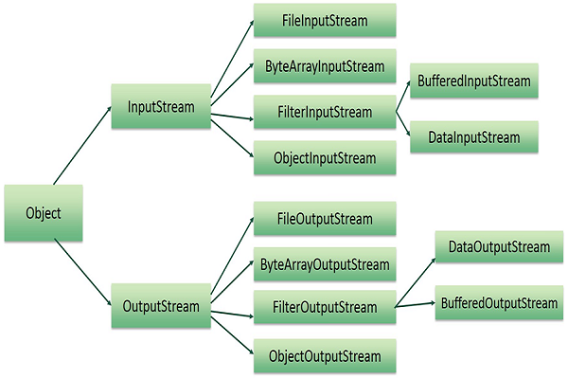
Reading and Writing Files
A stream can be defined as a sequence of data. The InputStream is used to read data from a source and the OutputStream is used for writing data to a destination.
Here is a hierarchy of classes to deal with Input and Output streams.

Slide 14
The two important streams are FileInputStream and FileOutputStream.
FileInputStream
This stream is used for reading data from the files. Objects can be created using the keyword new and there are several types of constructors available.
Following constructor takes a file name as a string to create an input stream object to read the file −
InputStream f = new FileInputStream("C:/java/hello");
Following constructor takes a file object to create an input stream object to read the file.
First we create a file object using File() method as follows −
File f = new File("C:/java/hello");
InputStream f = new FileInputStream(f);
Once you have InputStream object in hand, then there is a list of helper methods which can be used to read to stream or to do other operations on the stream.

Slide 15
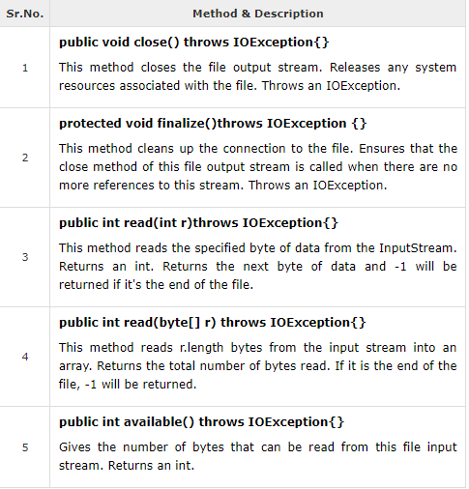

Slide 16
FileOutputStream
FileOutputStream is used to create a file and write data into it. The stream would create a file, if it doesn't already exist, before opening it for output.
Here are two constructors which can be used to create a FileOutputStream object.
Following constructor takes a file name as a string to create an input stream object to write the file −
OutputStream f = new FileOutputStream("C:/java/hello")
Following constructor takes a file object to create an output stream object to write the file. First, we create a file object using File() method as follows −
File f = new File("C:/java/hello");
OutputStream f = new FileOutputStream(f);
Once you have OutputStream object in hand, then there is a list of helper methods, which can be used to write to stream or to do other operations on the stream.

Slide 17
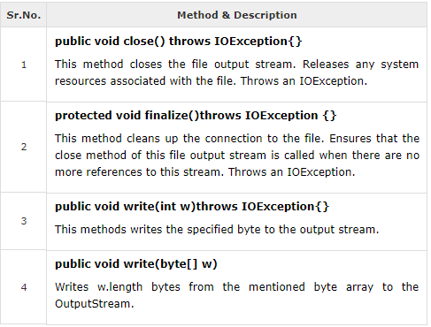

Slide 18
FileStreamTest.java
The above code would create file test.txt and would write given numbers in binary format. Same would be the output on the stdout screen.
File Navigation and I/O
There are several other classes that we would be going through to get to know the basics of File Navigation and I/O.
File Class
FileReader Class
FileWriter Class

Slide 19
Directories in Java
A directory is a File which can contain a list of other files and directories. You use File object to create directories, to list down files available in a directory. For complete detail, check a list of all the methods which you can call on File object and what are related to directories.
Creating Directories
There are two useful File utility methods, which can be used to create directories −
The mkdir( ) method creates a directory, returning true on success and false on failure. Failure indicates that the path specified in the File object already exists, or that the directory cannot be created because the entire path does not exist yet.
The mkdirs() method creates both a directory and all the parents of the directory.Following example creates “C:\MyDir" directory −
CreateDir.java

Slide 20
Listing Directories
You can use list( ) method provided by File object to list down all the files and directories available in a directory as follows −
ReadDir.java
This will produce the following result based on the directories and files available in your C:\ directory −
Program: How to get file last modified time?
Description:
Below example shows how to get last modified time of a file. lastModified() method gives you the last modified time of a file object.
FileLastModified.java
https://www.epochconverter.com/
How to find files with certain extension only
FindCertainExtension.java
How to get free disk space in Java
DiskSpaceDetail.java

